Slide 1

GISSA Meeting – 28 February 2020
Adrian Roos

Slide 2
Good Politician?
Notes:
22 May 11:39am

Slide 3
0,02
0,2%

Slide 4
Horrible Members
Notes:
A day in the life
Constituency

Slide 5

Mechanisms
Motion without notice
Members Statement
Motions
Questions
Petitions
Opinion Pieces
Media
Private Members’ Bills

Slide 6

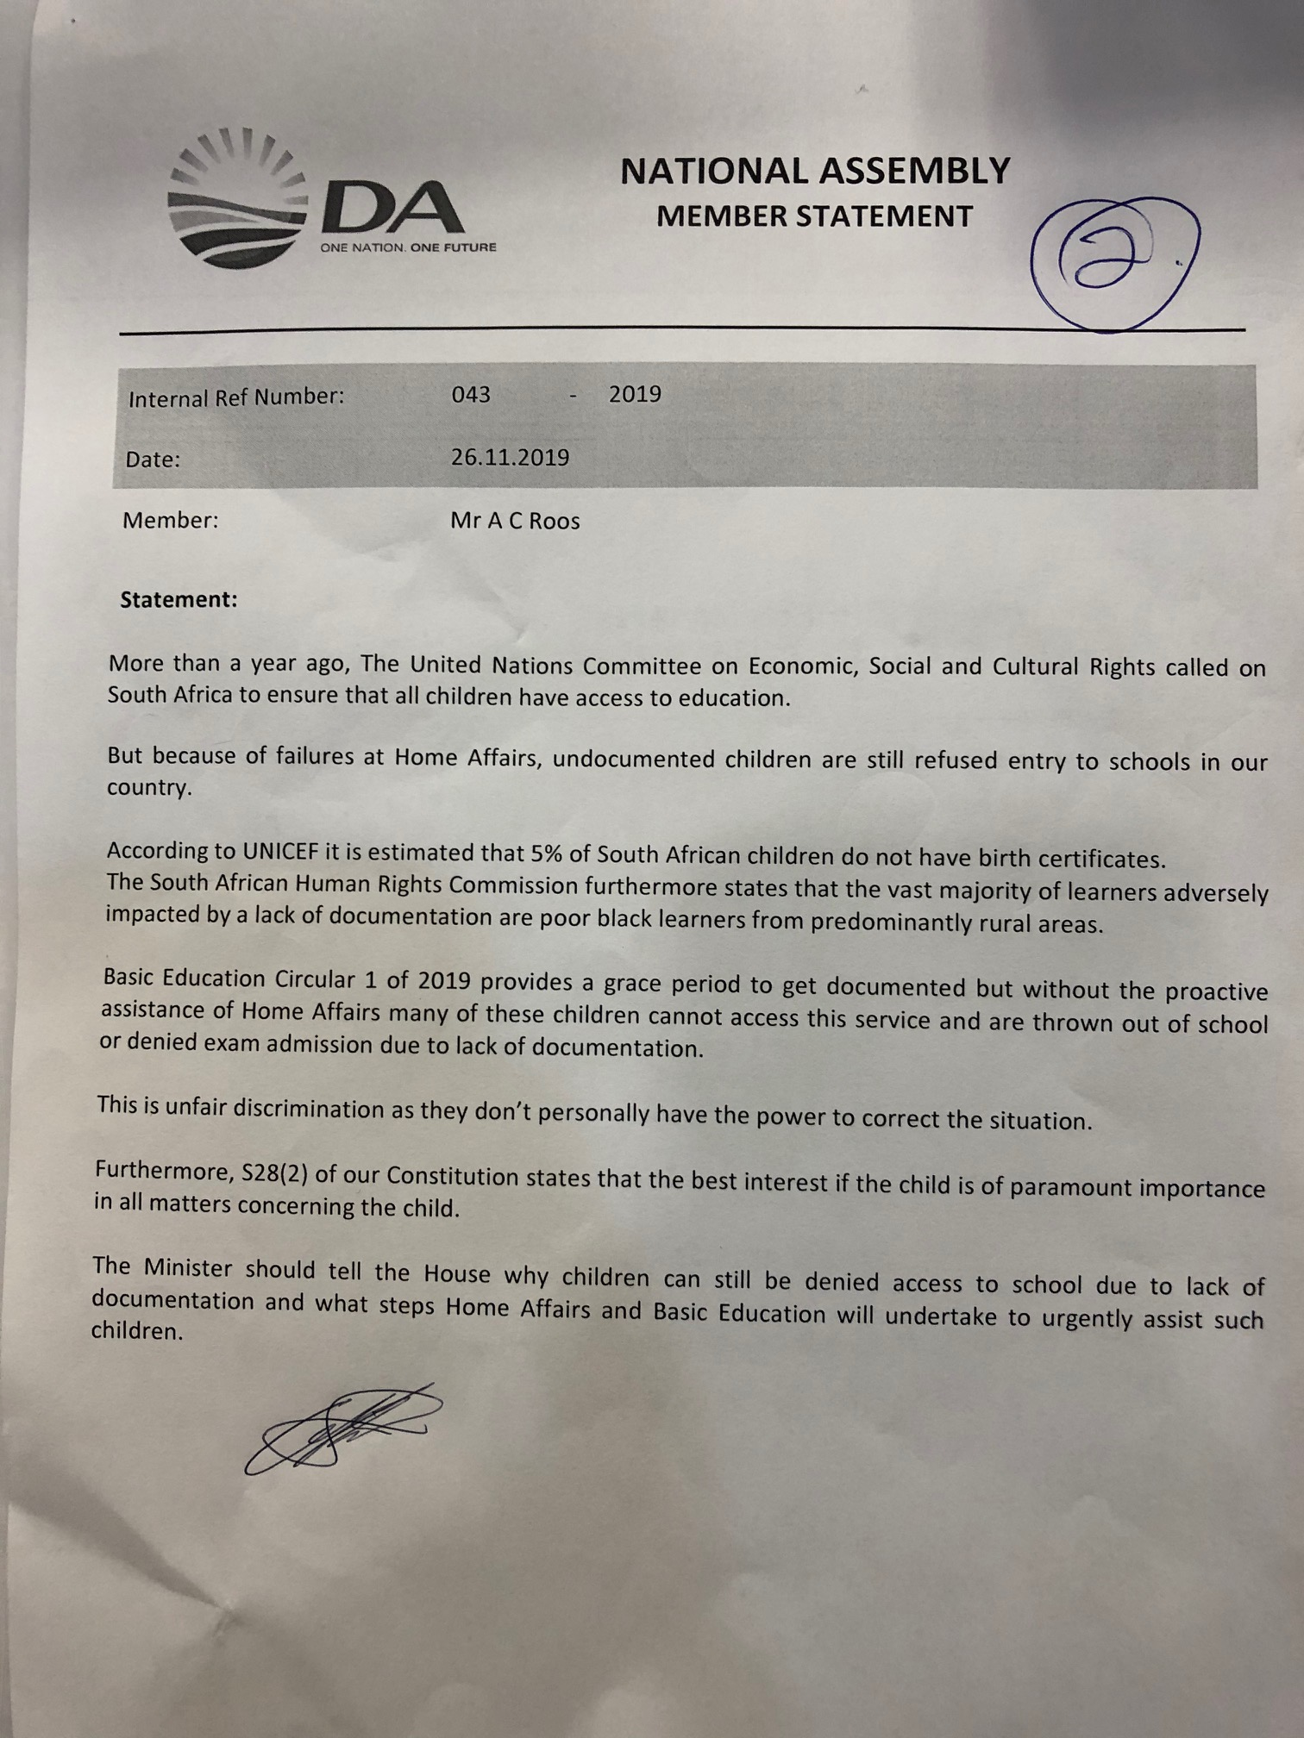
Mechanisms
Motion without notice
Members Statement
Motions
Questions
Petitions
Opinion Pieces
Media
Private Members’ Bills

Slide 7
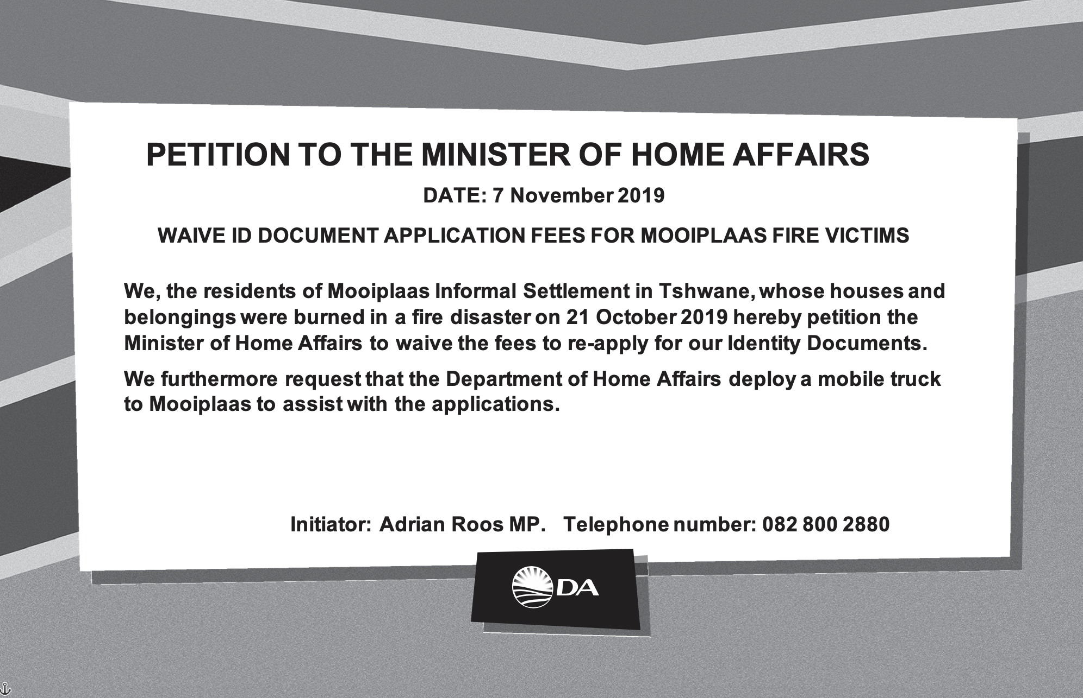
Mechanisms
Motion without notice
Members Statement
Motions
Questions
Petitions
Opinion Pieces
Media
Private Members’ Bills

Slide 8
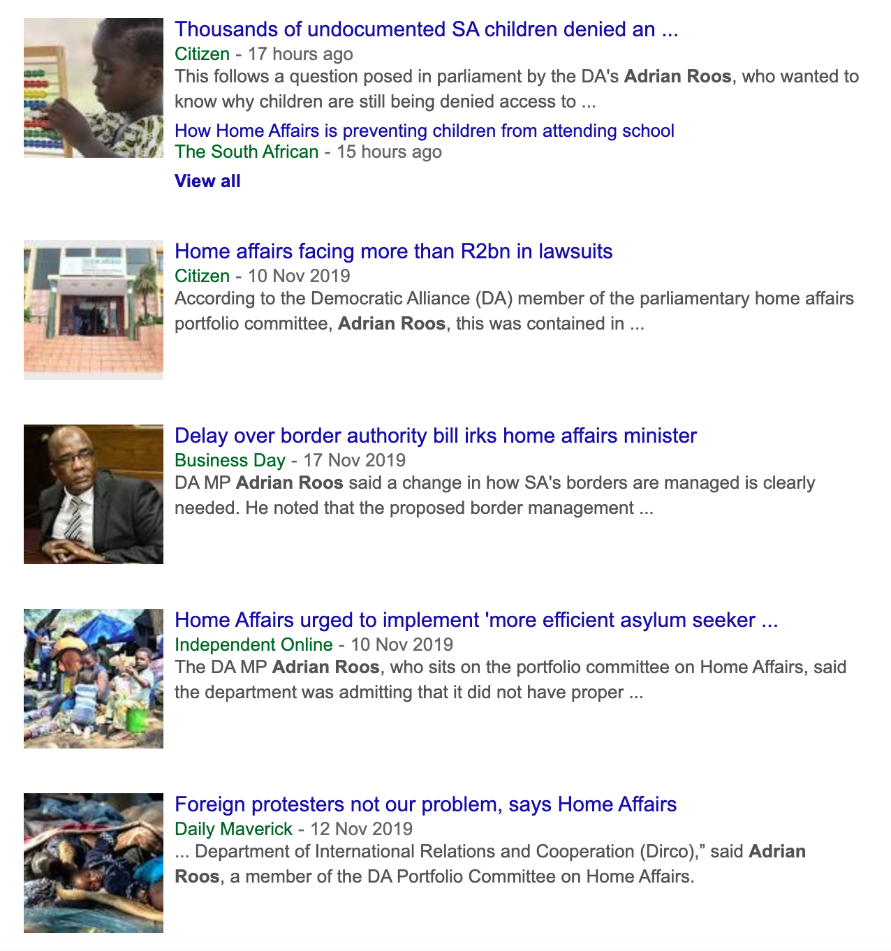
Mechanisms
Motion without notice
Members Statement
Motions
Questions
Petitions
Opinion Pieces
Media
Private Members’ Bills

Slide 9
Perception
Notes:
All of these mechanisms are to influence
Views on Maps
Accessibility study

Slide 10

Outcome
Notes:
Biggest challenges of our time
Position in Planning

Slide 11
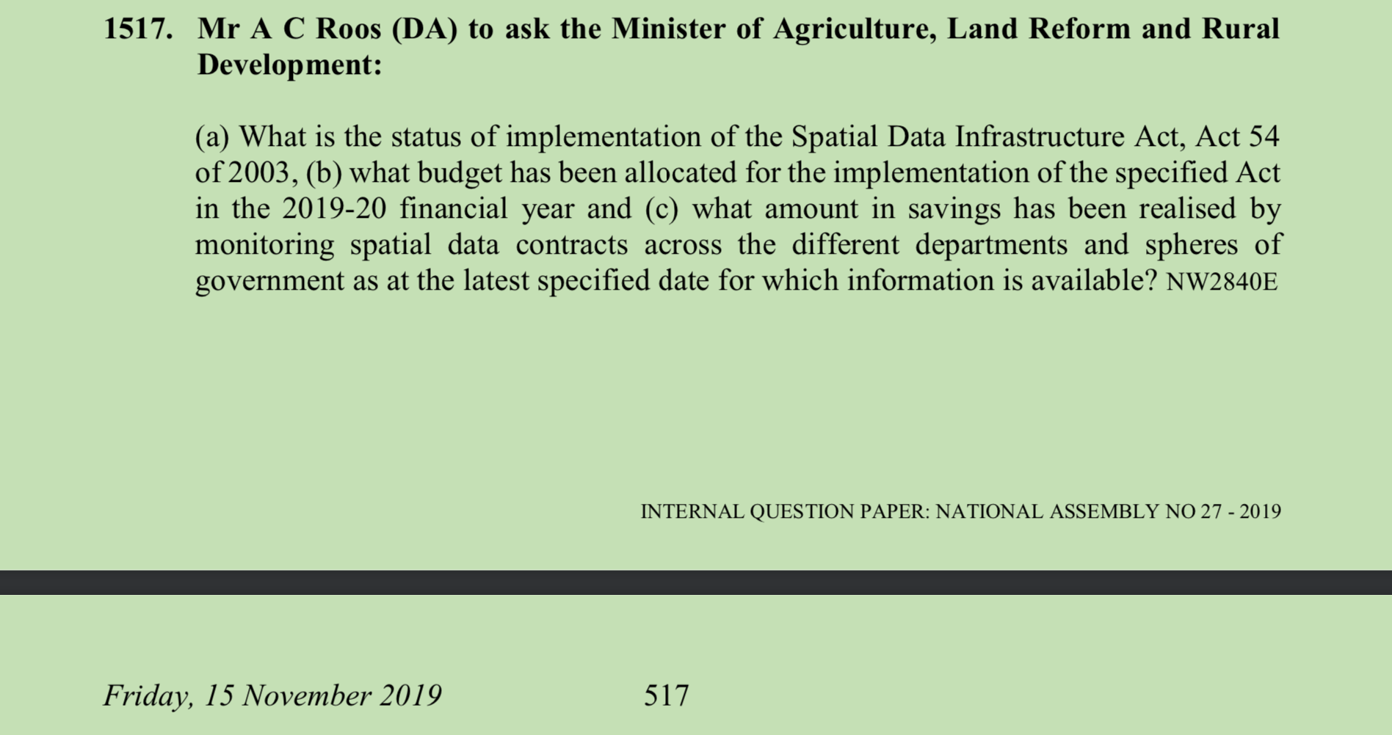
Themes: SDI Funding & Compliance
Text
Notes:
Currently the Department has not quantified the savings with regard to the monitoring of spatial information contracts across the different departments and spheres of government. The compliance with Regulation 5 of the Act is still very minimal. Organs of state still continue to embark on exercises to capture spatial data and/or information without receiving the necessary permission from the CSI as required in terms of Regulation 5. As a result, the Department together with the CSI is engaging National Treasury to develop a cost-saving model that will be achieved by implementation of Regulation 5.

Slide 12
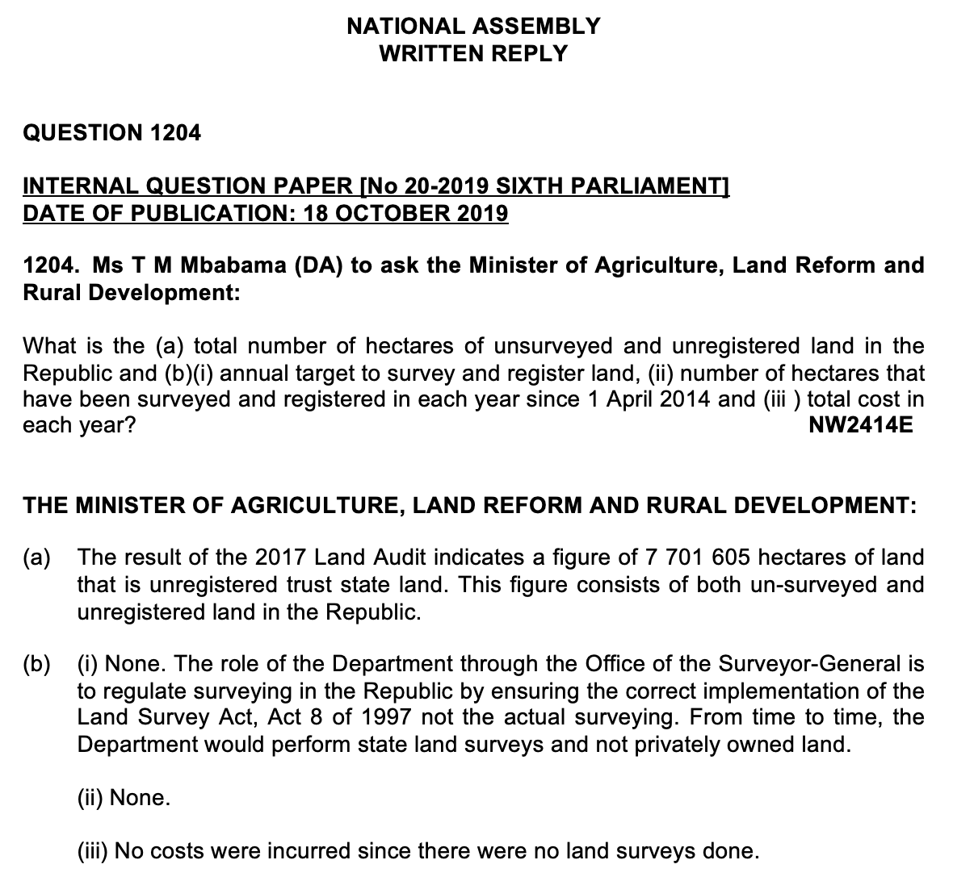
Themes: Necessity for core datasets
Notes:
SAPO Addressing
Cadastre

Slide 13
Discussion
?
Notes:
Issues
Working group or quarterly

Slide 14


